Slide 1
r01lib and r01device C++ libraries for easy MCU operation
Akifumi OKANO
CAS-Japan
2024-December-10

Slide 2
Executive summary
Libraries are available which enables to write I3C/I2C/SPI applications easy on MCX mocrocontrollers!
Same application code works on any supported MCX boards
‘r01lib’ and ’r01device’ are the libraries provides simple API to operate MCU features/peripherals
The libraries are suitable for writing demo code and hands-on for introducing devices
Any comment, request, bug-report and pull-request are welcome ☺
→ akifumi.okano@nxp.com

Slide 3
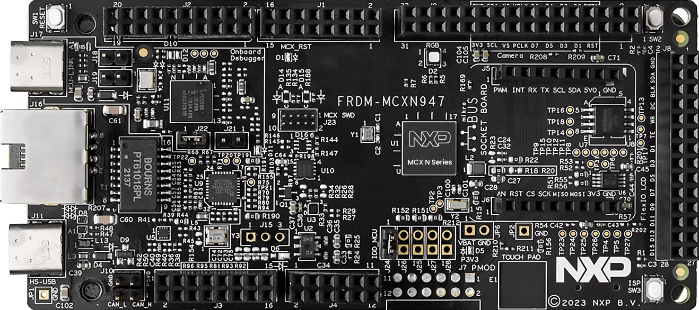
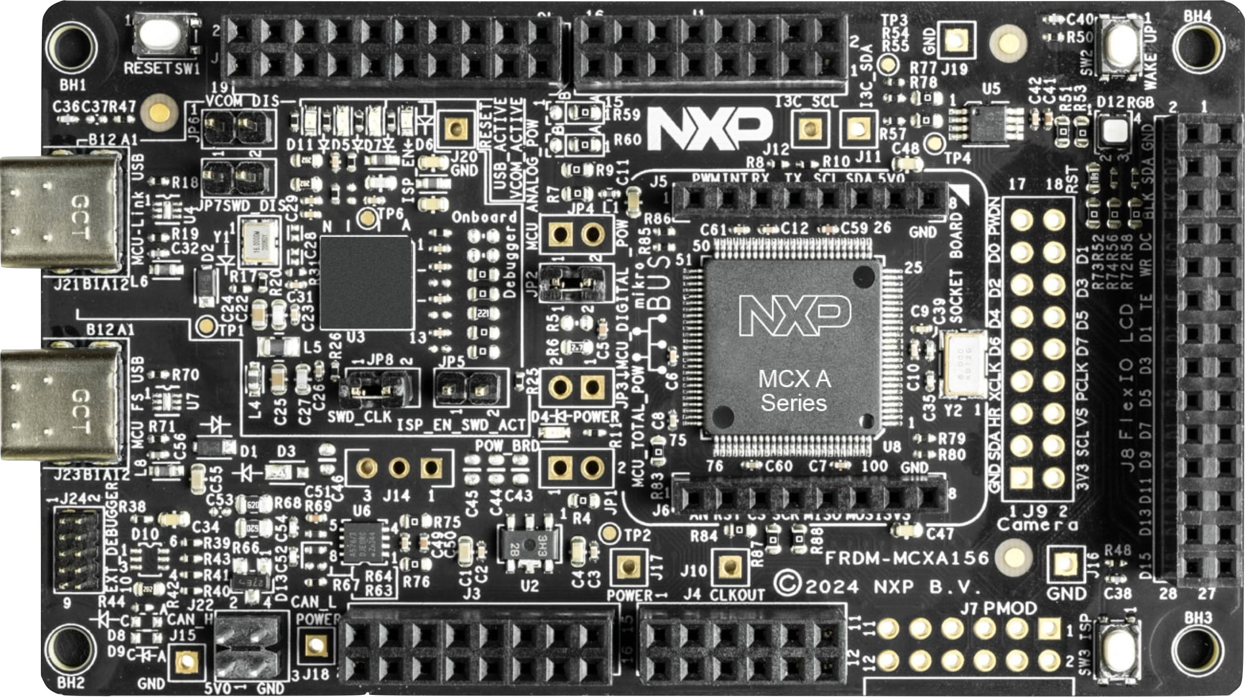
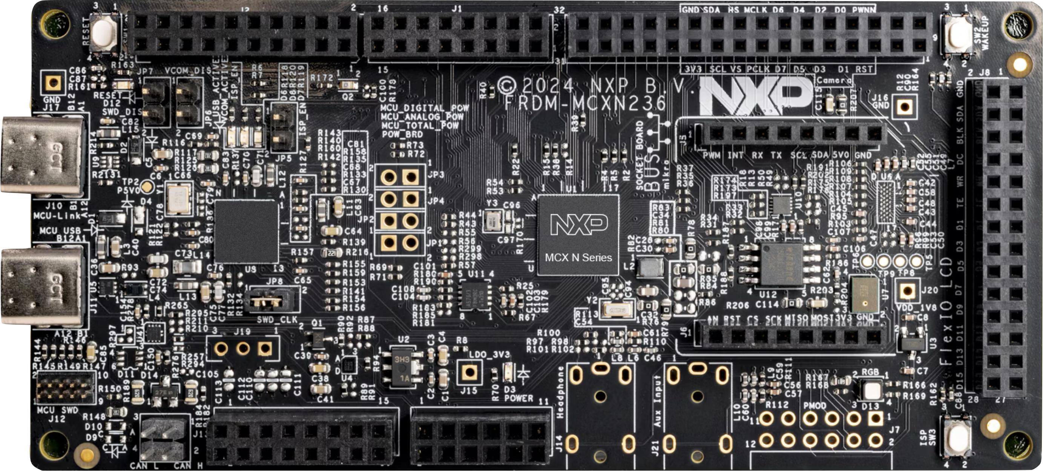
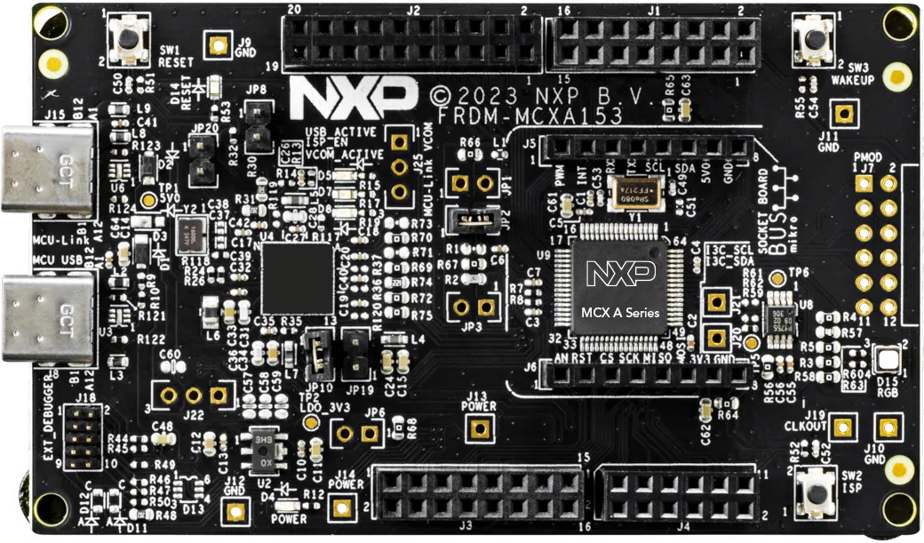
Supported MCU boards
NEW!
FRDM-MCXN947
FRDM-MCXA156
FRDM-MCXN236
FRDM-MCXA153

Slide 4
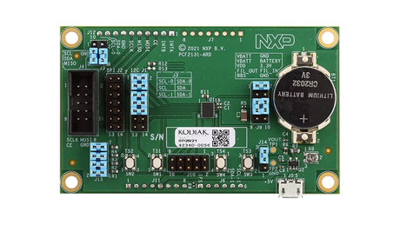
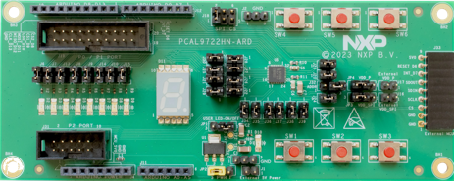
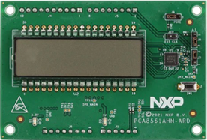
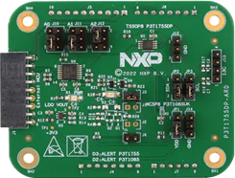
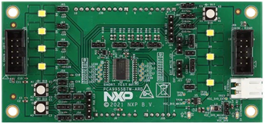
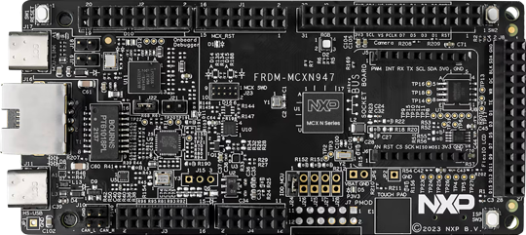
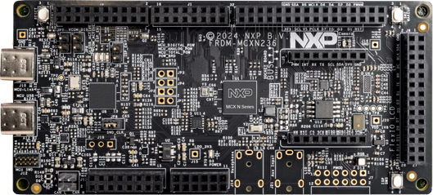
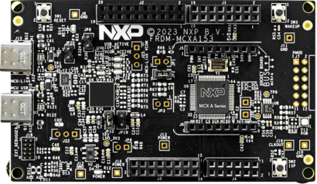
For instance.. : Evaluation board sample code can run any MCX with r01lib
RTC
(I²C/SPI)
GPIO
(I²C/SPI)
LCD
(I²C)
Temp sens.
(I3C)
LED
(I²C/SPI)
R01 Arduino shield (ARD) boards
App
App
App
App
App
Application for each ARD boards
Written on “r01lib”. Same code runs on any MCX boards
r01lib (+ r01device)
“r01lib” is an abstraction layer for MCXs
Abstracting I3C, I²C, SPI, GPIO, Timer, Interrupt with simple C++ API
SDK
SDK
SDK
SDK
SDK for each MCX boards
Drivers for each MCU and peripherals
FRDM-MCX boards
FRDM-MCXN947
FRDM-MCXN236
FRDM-MCXA156
FRDM-MCXA153

Slide 5
Hardware/Software structure
Application
r01device
r01lib
MCUXpresso SDK
API cals
FRDM-MCXNxxx / FRDM-MCXAxxx
Register access
I²C/I3C/SPI/GPIO
R01 products
Software
Hardware

Slide 6
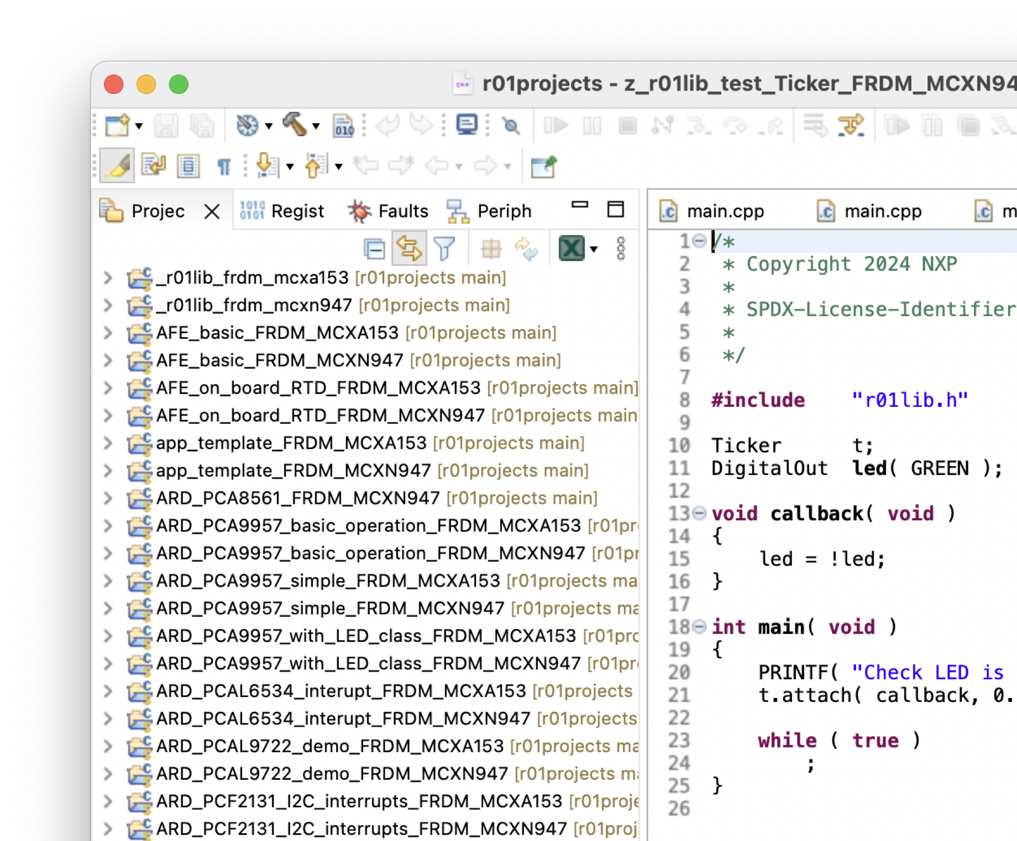
How will it be looked like?
The r01lib is delivered as a part of sample code
The r01lib is made as library project
for each MCU boards
Various sample code projects those will be linked with r01lib library

Slide 7
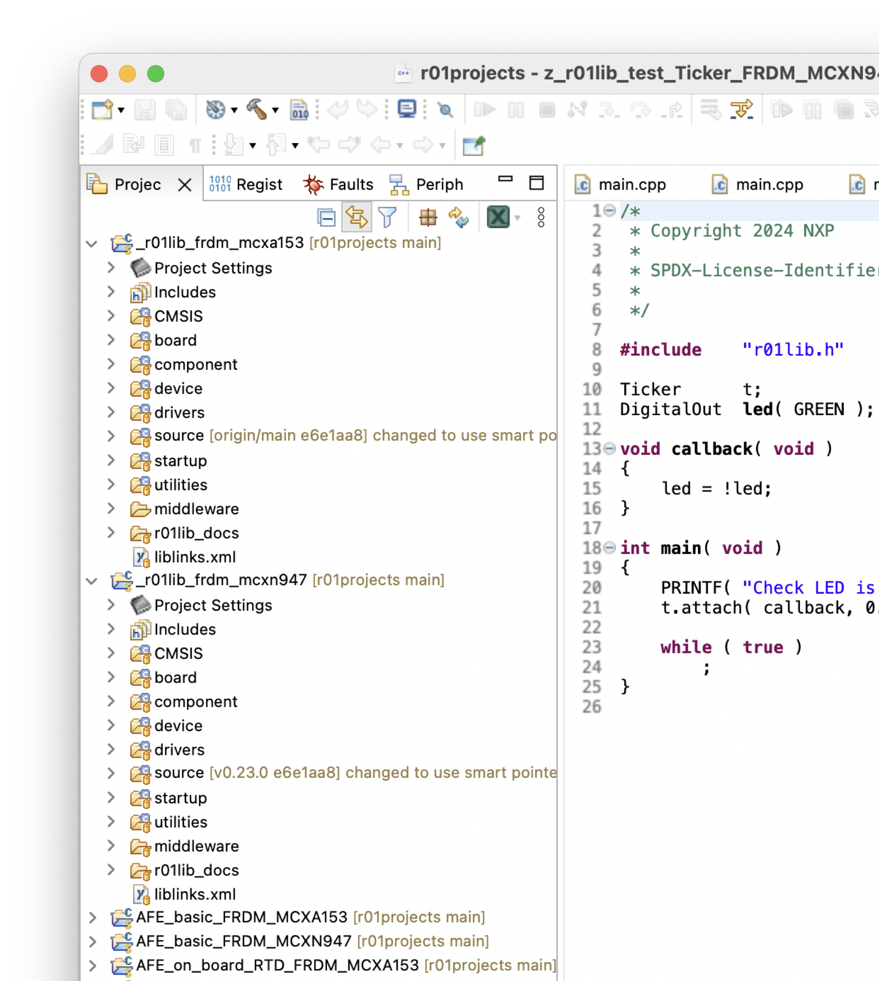
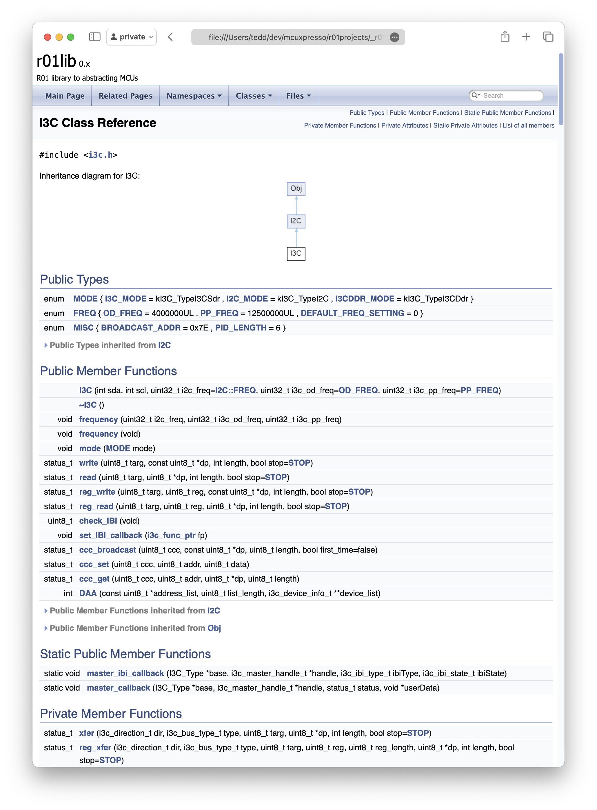
API documents are available

Slide 8
r01lib
00
MCU abstraction layer

Slide 9
Library for abstracting MCU on MCUXpresso Simple interface to write sample code
r01lib = A driver collection for MCU’s bus/pin operations
Problem so far
The MCUXpresso SDK drivers are available in low level. It is good to software engineer who needs to derive maximum MCU performance but not easy to use for everyone
Assigning MCU pin requires low level port and clock settings or use of “Config Tool”
MCX desn’t have user friendly development environment like other MCUs yet. For instance, “Mbed” and “Arduino” are not adopted for MCX those are popular SDKs providing simple API with abstracting MCUs.
What has been done
Made a small set of library which controls I3C, I2C, SPI, GPIO, pin-interrupt and timer
The user-interface is made like Mbed SDK: Features and pins can be operated with high level simple interface
wait() function to control timing
The library can be bundled with demo code as a MCUXpresso project
The library is ported to FRDM-MCXN947, FRDM-MCXN236, FRDM-MCXA156 and FRDM-MCXA153. The library make possible to run same code on both evaluation boards

Slide 10
Available APIs
DigitalInOut / DigitalIn / DigitalOut class
BusInOut / BusIn / BusOut classes
InterruptIn class
Ticker class
I2C class
I3C class
SPI class
Wait function

Slide 11
r01lib operation sample
01
Simple API

Slide 12
Sample 0 : DigitalOut LED blink
#include "r01lib.h"
DigitalOut led( GREEN );
int main(void)
{
while ( 1 )
{
led = !led;
wait( 0.5 );
}
}
GPIO can be controlled by simple interface
No need to care about GPIO registers
Pin names are defined in “component/r01lib/io.h”
Wait() takes float number (seconds). Down to microsecond resolution

Slide 13
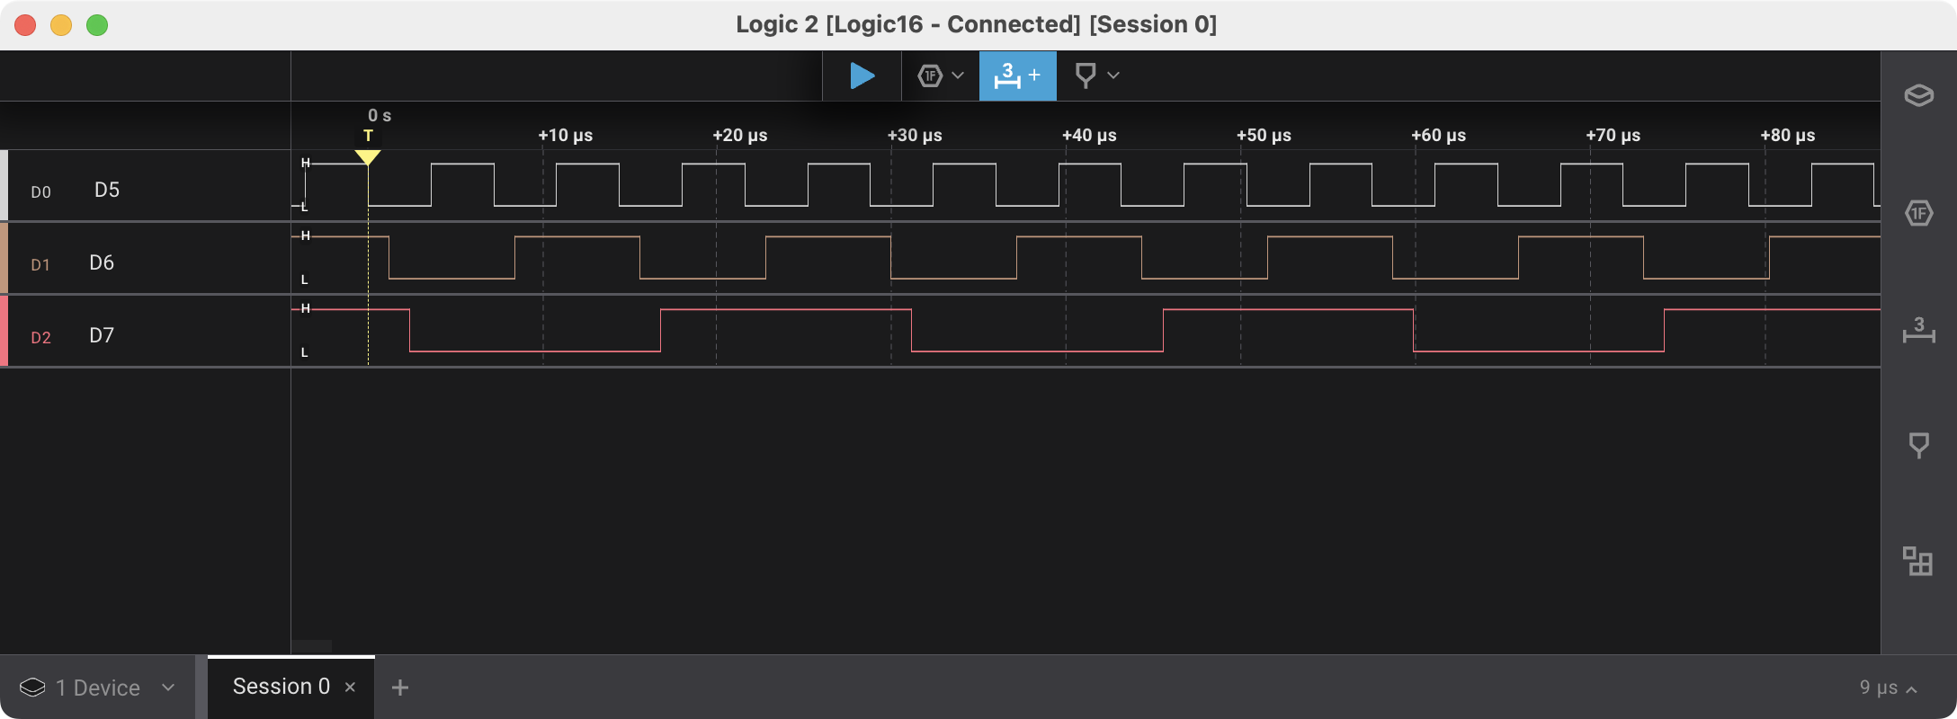
Sample 2 : DigitalOut Flips GPIO pins
#include "r01lib.h"
DigitalOut d5( D5 );
DigitalOut d6( D6 );
DigitalOut d7( D7 );
int main(void)
{
int count = 0;
while ( 1 )
{
d5 = (count >> 0) & 0x01;
d6 = (count >> 1) & 0x01;
d7 = (count >> 2) & 0x01;
count++;
}
}
It can handle multiple GPIOs
Input can be done by DigitalIn and DigitalInOut classes

Slide 14
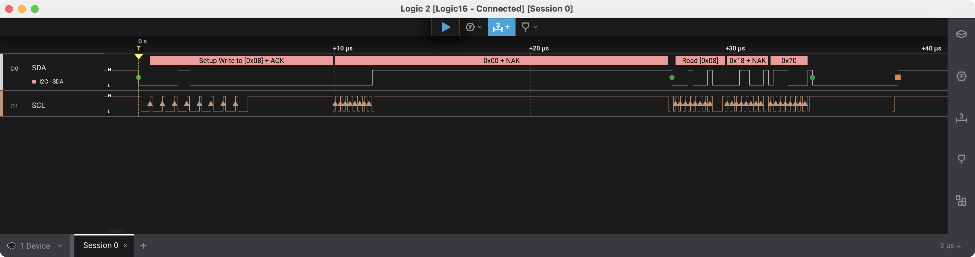
Sample 3 : I2C Low level P3T1755 access
#include "r01lib.h"
I2C i2c( I2C_SDA, I2C_SCL );
int main( void )
{
constexpr uint8_t address = 0x4C;
uint8_t w_data[] = { 0 };
uint8_t r_data[ 2 ];
while ( true )
{
i2c.write( address, w_data, sizeof( w_data ), I2C::NO_STOP );
i2c.read( address, r_data, sizeof( r_data ) );
printf( "0x %02X %02X\r\n", r_data[ 0 ], r_data[ 1 ] );
wait( 1 );
}
}
I2C class provides a simple interface to perform transfer

Slide 15
Available pins
02
FRDM-MCXN947
FRDM-MCXN236
FRDM-MCXA156
FRDM-MCXA153

Slide 16
Pins
FRDM-MCXN947

Slide 17
FRDM-MCXN947 Arduino socket
sda
scl
D19
I2C_SDA
I2C
D18
I2C_SCL
AREF
0V
GND
NC
sclk
miso
mosi
cs
D13
REF
IOREF (3.3V)
SPI
D12
nR
D11
VOUT
3.3V Regulated Out
D10
GREEN
VU
5.0V USB Out
D9
RED
GND
0V
D8
GND
0V
NC
D7
BLUE
D6
D5
D4
A2
D3
A3
D2
A4
D1
A5
D0
sda scl
I3C_SDA
* Note: A5 pin is tied to 10kΩ pull-up and 100nF capacitor to GND on board
I3C
I3C_SCL
All pin sockets can be used by defining pin like “P1_17”
This page shows pin sockets having special name
= Pin names which can be used in the code

Slide 18
FRDM-MCXN947 mikroBUS socket
MB_PWM
MB_RST
MB_INT
MB_CS
sda scl
MB_RX
I3C_SDA
MB_SCK
I3C
MB_TX
I3C_SCL
MB_MISO
scl
sda
MB_SCL
MB_MOSI
I2C
MB_SDA
VOUT
3.3V Regulated Out
5.0V USB Out
VU
GND
0V
0V
GND
All pin sockets can be used by defining pin like “P1_17”
This page shows pin sockets having special name
= Pin names which can be used in the code

Slide 19
Available pins N947

Slide 20
Pins
FRDM-MCXN236

Slide 21
FRDM-MCXN236 Arduino socket
sda
scl
D19
I3C_SDA
I3C
D18
I3C_SCL
AREF
0V
GND
NC
sclk
miso
mosi
cs
D13
REF
IOREF (3.3V)
SPI
D12
nR
D11
VOUT
3.3V Regulated Out
D10
GREEN
VU
5.0V USB Out
D9
RED
GND
0V
D8
GND
0V
NC
D7
BLUE
D6
A0
D5
A1
D4
BLUE
A2
D3
I2C_SDA
A3
D2
A4
sda
scl
D1
I2C_SCL
I2C
A5
D0
All pin sockets can be used by defining pin like “P1_17”
This page shows pin sockets having special name
= Pin names which can be used in the code

Slide 22
FRDM-MCXN236 mikroBUS socket
MB_AN
MB_PWM
RED
MB_RST
MB_INT
MB_CS
MB_RX
MB_SCK
MB_TX
MB_MISO
scl
sda
MB_SCL
MB_MOSI
I2C
MB_SDA
VOUT
3.3V Regulated Out
5.0V USB Out
VU
GND
0V
0V
GND
All pin sockets can be used by defining pin like “P1_17”
This page shows pin sockets having special name
= Pin names which can be used in the code

Slide 23
Available pins N236

Slide 24
Pins
FRDM-MCXA156

Slide 25
FRDM-MCXA156 Arduino socket
sda
scl
D19
I2C_SDA
I3C_SDA
I2C/I3C
D18
I2C_SCL
I3C_SCL
AREF
0V
GND
NC
D13
SPI is not available on D10~D13
REF
IOREF (3.3V)
D12
nR
D11
VOUT
3.3V Regulated Out
D10
GREEN
VU
5.0V USB Out
D9
GND
0V
D8
GND
0V
NC
D7
D6
A0
D5
A1
D4
RED
A2
D3
To use I²C on A4/A5, remove R75 and R76
A3
D2
A4
D1
A5
D0
All pin sockets can be used by defining pin like “P1_17”
This page shows pin sockets having special name
= Pin names which can be used in the code

Slide 26
FRDM-MCXA156 mikroBUS socket
MB_AN
MB_PWM
MB_RST
MB_INT
MB_CS
cs
sclk
miso
mosi
MB_RX
MB_SCK
SPI
scl
MB_TX
MB_MISO
I2C
MB_SCL
scl
sda
I2C
I2C
MB_MOSI
sda
MB_SDA
VOUT
3.3V Regulated Out
5.0V USB Out
VU
GND
0V
0V
GND
All pin sockets can be used by defining pin like “P1_17”
This page shows pin sockets having special name
= Pin names which can be used in the code

Slide 27
Available pins A156

Slide 28
Pins
FRDM-MCXA153

Slide 29
FRDM-MCXA153 Arduino socket
The I3C can be routed to D18 and D19 pins by declaring as I3C( I2C_SDA, I2C_SCL )
sda
scl
D19
I2C_SDA
I2C/I3C
D18
I2C_SCL
AREF
0V
GND
NC
sclk
miso
mosi
cs
D13
REF
IOREF (3.3V)
SPI
D12
nR
D11
VOUT
3.3V Regulated Out
D10
VU
5.0V USB Out
D9
GND
0V
D8
GND
0V
NC
D7
GREEN
D6
RED
A0
D5
A1
D4
BLUE
A2
D3
A3
D2
A4
D1
A5
D0
scl
sda
I2C
scl
sda
I3C_SDA
All pin sockets can be used by defining pin like “P1_17”
This page shows pin sockets having special name
I3C
I3C_SCL
= Pin names which can be used in the code

Slide 30
FRDM-MCXA153 mikroBUS socket
MB_AN
MB_PWM
MB_RST
MB_INT
MB_CS
MB_RX
MB_SCK
scl
MB_TX
MB_MISO
I2C
scl
sda
MB_SCL
I2C
I2C
MB_MOSI
sda
MB_SDA
VOUT
3.3V Regulated Out
5.0V USB Out
VU
GND
0V
0V
GND
All pin sockets can be used by defining pin like “P1_17”
This page shows pin sockets having special name
= Pin names which can be used in the code

Slide 31
Available pins A153

Slide 32
Example of defining I3C pins from code on FRDM-MCXA153
#include "r01lib.h"
I2C i2c( I2C_SDA, I2C_SCL );
sda
scl
D19
I2C_SDA
I2C/I3C
D18
I2C_SCL
AREF
#include "r01lib.h"
I3C i3c( I3C_SDA, I3C_SCL );
0V
GND
D13
D12
D11
D10
#include "r01lib.h"
I3C i3c( I2C_SDA, I2C_SCL );
D9
D8
D7
GREEN
D6
RED
D5
D4
BLUE
D3
D2
For instance, in I3C case, the signals can be changed to re-route the signals to D18 and D19 by giving arguments for constructor.
D1
D0
scl
sda
I2C
scl
sda
I3C_SDA
I3C
I3C_SCL

Slide 33
Example of defining I3C pins from code on FRDM-MCXN947
sda
scl
D19
I2C_SDA
I2C
D18
I2C_SCL
AREF
#include "r01lib.h"
I2C i2c( I2C_SDA, I2C_SCL );
0V
GND
sclk
miso
mosi
cs
D13
SPI
D12
D11
D10
GREEN
#include "r01lib.h"
I3C i3c( I3C_SDA, I3C_SCL );
D9
RED
D8
D7
BLUE
D6
D5
#include "r01lib.h"
I3C i3c( I2C_SDA, I2C_SCL );
D4
D3
D2
D1
D0
sda scl
I3C_SDA
I3C
I3C_SCL
On FRDM-MCXN947, the I3C signals cannot be assigned to D18 and D19 because hardware doesn’t allow this configuration

Slide 34
r01device
03
R01 product operation sample library

Slide 35
Library for R01 products operation on MCUXpresso Simple interface to write sample code
r01device = A class driver correction for r01 device operations
Delivered as a part of r01lib
Abstracting device operation
To present devices’ main features with simple interfaces
User don’t need to care register level operation
If user need to access register, it can be done through register access APIs

Slide 36
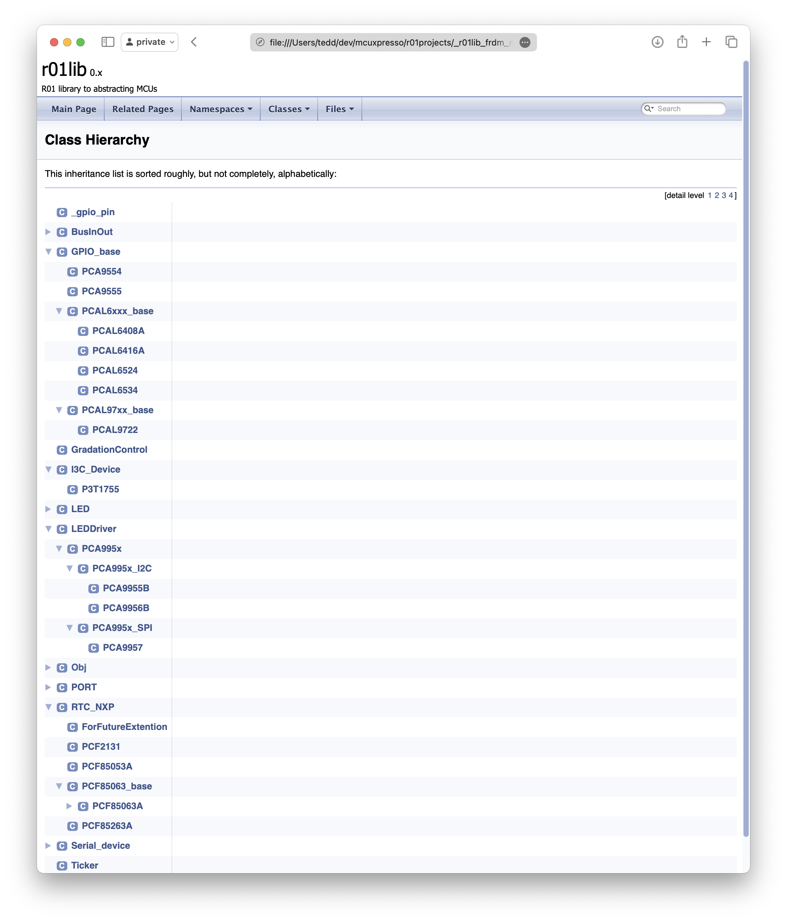
Available device classes
All available classes can be found on online document

Slide 37
r01device operation sample
04
Simple API

Slide 38
Sample 1 : P3T1755 Interface to temp sensor
#include "r01lib.h"
I3C i3c( I3C_SDA, I3C_SCL );
P3T1755 p3t1755( i3c );
int main(void)
{
float temp;
i3c.ccc_broadcast( CCC::BROADCAST_RSTDAA, NULL, 0 );
i3c.ccc_set( CCC::DIRECT_SETDASA, 0x48, 0x08 << 1 );
p3t1755.address_overwrite( 0x08 );
while ( true )
{
temp = p3t1755;
printf( "Temperature: %8.4f˚C\r\n", temp );
wait( 1 );
}
}
P3T1755 class makes an interface for the I3C device
Register level access is abstracted
This sample is using CCC interface in I3C class

Slide 39
Sample 2 : PCA9955B Interface to LED driver
#include "r01lib.h"
#include "led/PCA9955B.h"
I2C i2c( I2C_SDA, I2C_SCL );
PCA9955B ledd( i2c );
int main(void)
{
ledd.begin( 1.0, PCA9955B::ARDUINO_SHIELD );
while ( true )
{
ledd.pwm( 0, 1.0 );
wait( 0.1 );
ledd.pwm( 0, 0.0 );
wait( 0.1 );
}
}
PCA9955B class makes an interface for the LED driver
PWM can be controlled through instance method

Slide 40
Sample 3 : PCF2131 Interface to RTC
#include "r01lib.h"
#include <time.h>
#include "rtc/PCF2131_I2C.h”
I2C i2c( I2C_SDA, I2C_SCL );
PCF2131_I2C rtc( i2c );
int main(void)
{
while ( true )
{
time_t current_time = rtc.time( NULL );
printf( "time: %s", ctime(&current_time) );
wait( 1 );
}
}
PCF2131 class makes an interface for the RTC
The interface data format is compatible with “time.h” in C standard lib.

Slide 41
Repository
05
Access to the code

Slide 42
Repo
https://github.com/teddokano/r01lib_MCUXpresso
Including both r01lib and r01device source code
This repo including sample/test code for available features
DigitalInOut, DigirtalIn, DigitalOut, BusInOut, BusIn, BusOut, InterruptIn, Ticker, I3C, I2C, SPI classes
The device usage samples with ‘r01device’ are available in https://github.com/teddokano/r01projects
This repo is hidden by some reasons. But all you are welcome to join to see this. Please let OKANO know your GitHub to invite!
Sample code to operate ..
NAFE13388, PCA8561, PCA9957, PCAL6534, PCAL9722, PCF2131(I²C&SPI), P3T1755

Slide 43
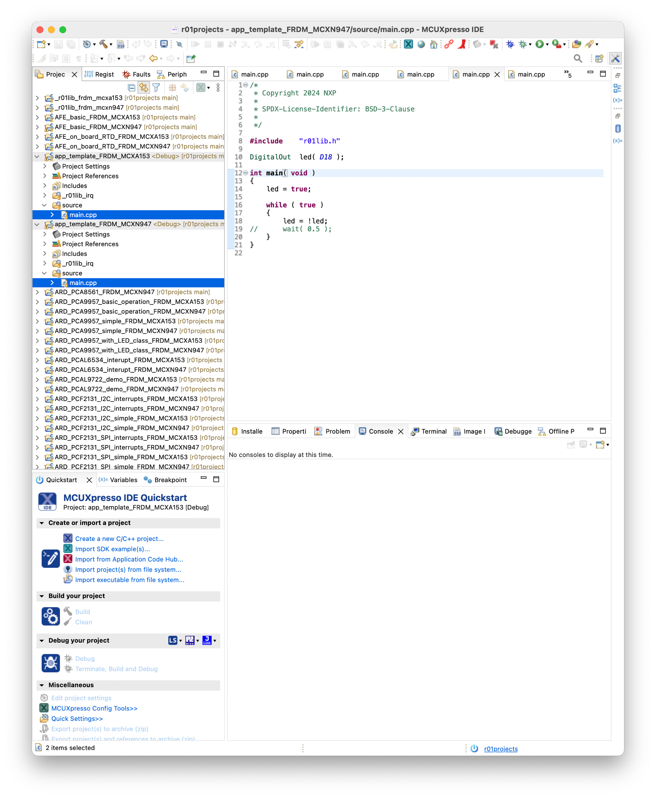
How to start writing your own code Write your code
Choose template project and overwrite
source/main.cpp .
If needed, new files (.c/.cpp/.h) can be added in source/ folder.

Slide 44
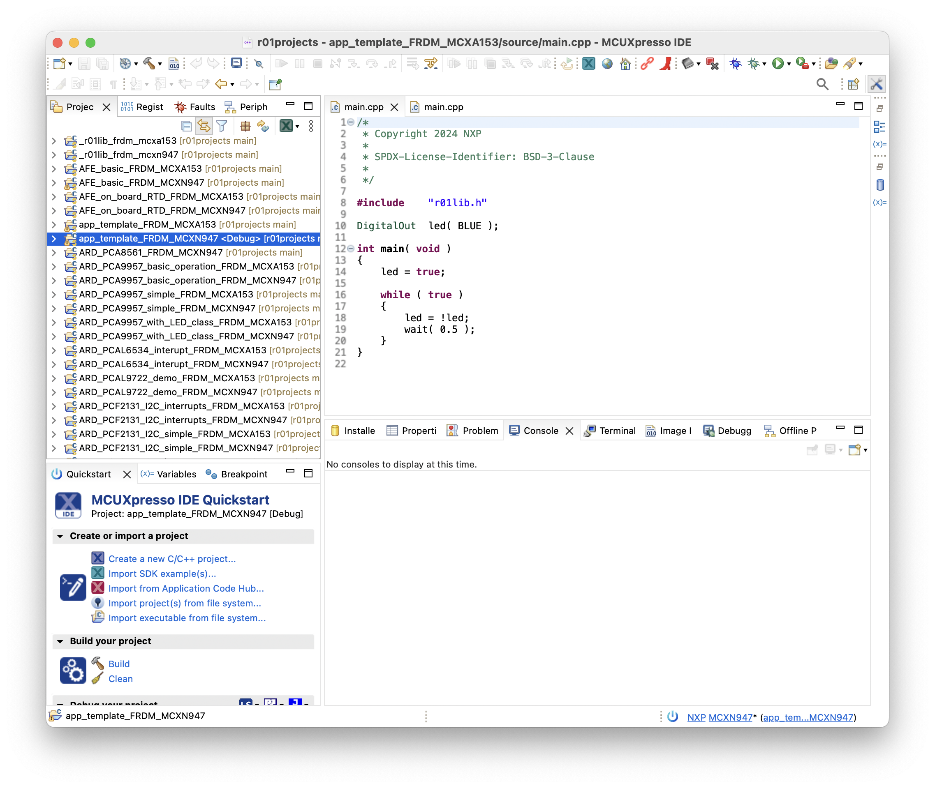
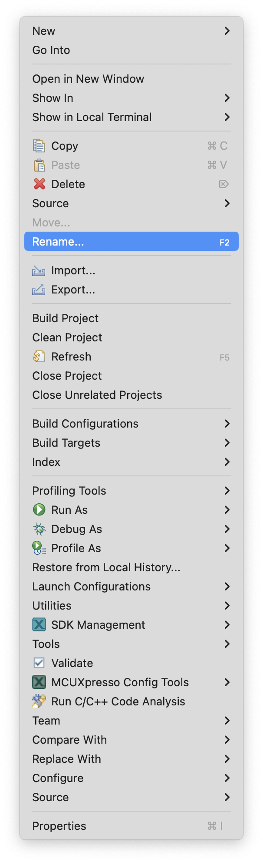
How to start writing your own code Code exporting: step1
Rename the project
Right click on the project and choose “Rename…” from pop-up menu

Slide 45
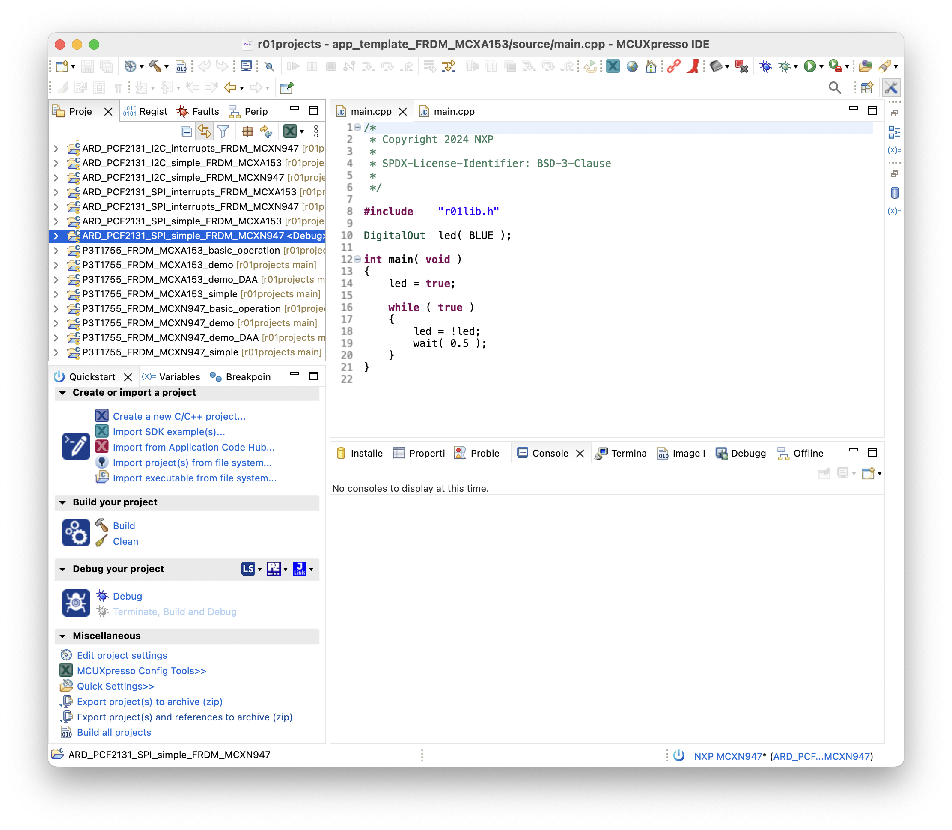
Code distribution: step2
Choose the project(s)
Click on “Export project(s) and reference to archive (zip)”

Slide 46
History
06

Slide 47
Document revision history
Date | Updates
2024 Mar 21 | Initial version
2024 May 29 | Pin name information added
2024 Jul 17 | FRDM-MCXN236 support added
2024 Dec 09 | FRDM-MCXA156 support added
2024 Dec 10 | Available pins tables updated to clarify the pins which have multiple names

